Slide 1
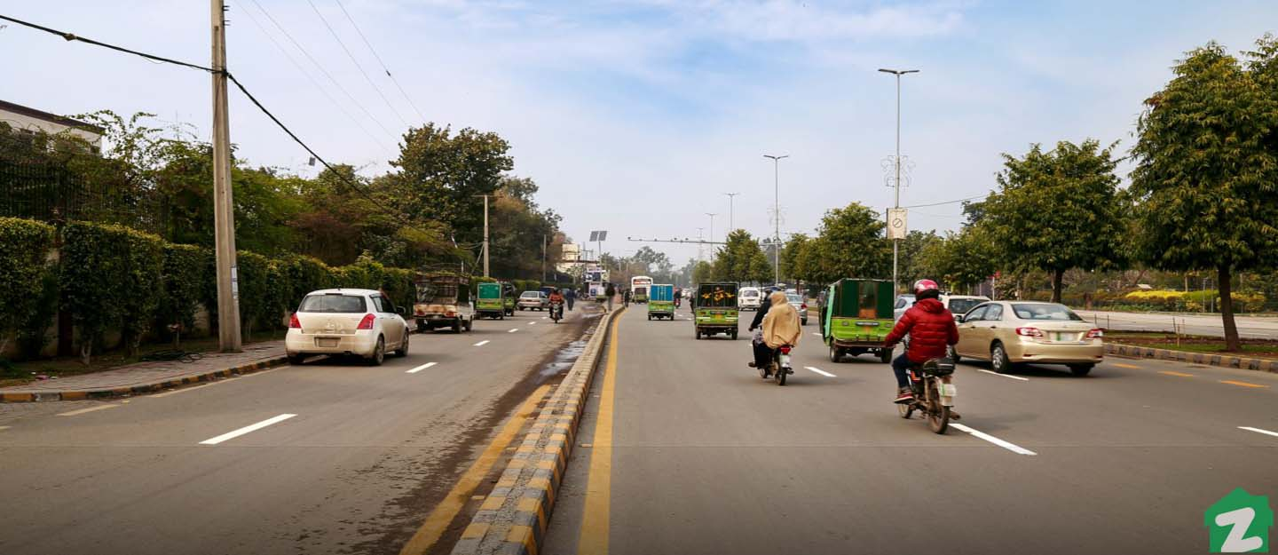




COMBATING DOMESTIC VIOLENCE WITH AI
Using Deep Learning Classification to Identify Potential Victims and Perpetrators of Spousal Violence in Pakistan
TEAM LEADS:
MEHR-UN-NISA ARIF KITCHLEW
SHEHREYAR ARIF KITCHLEW

Slide 2

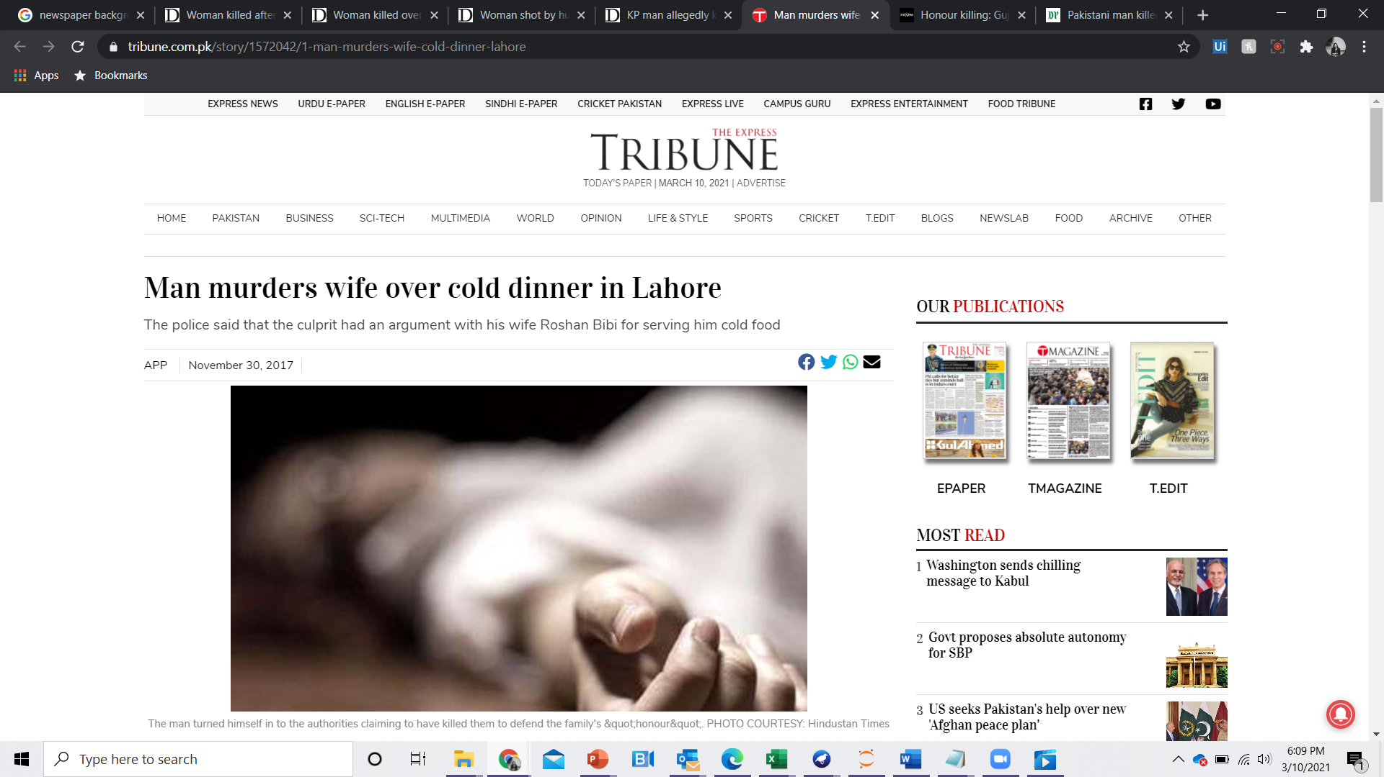
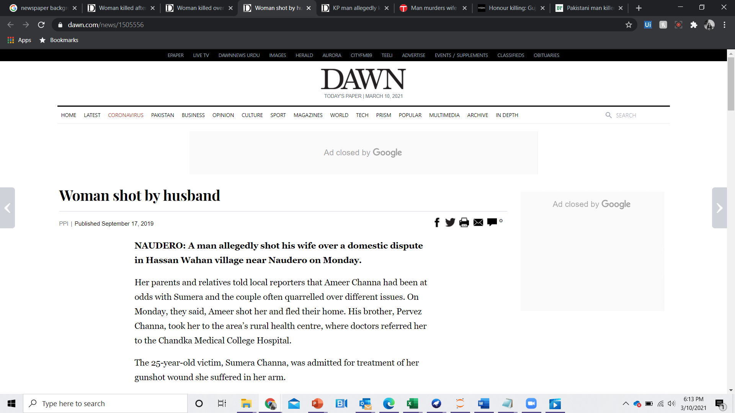
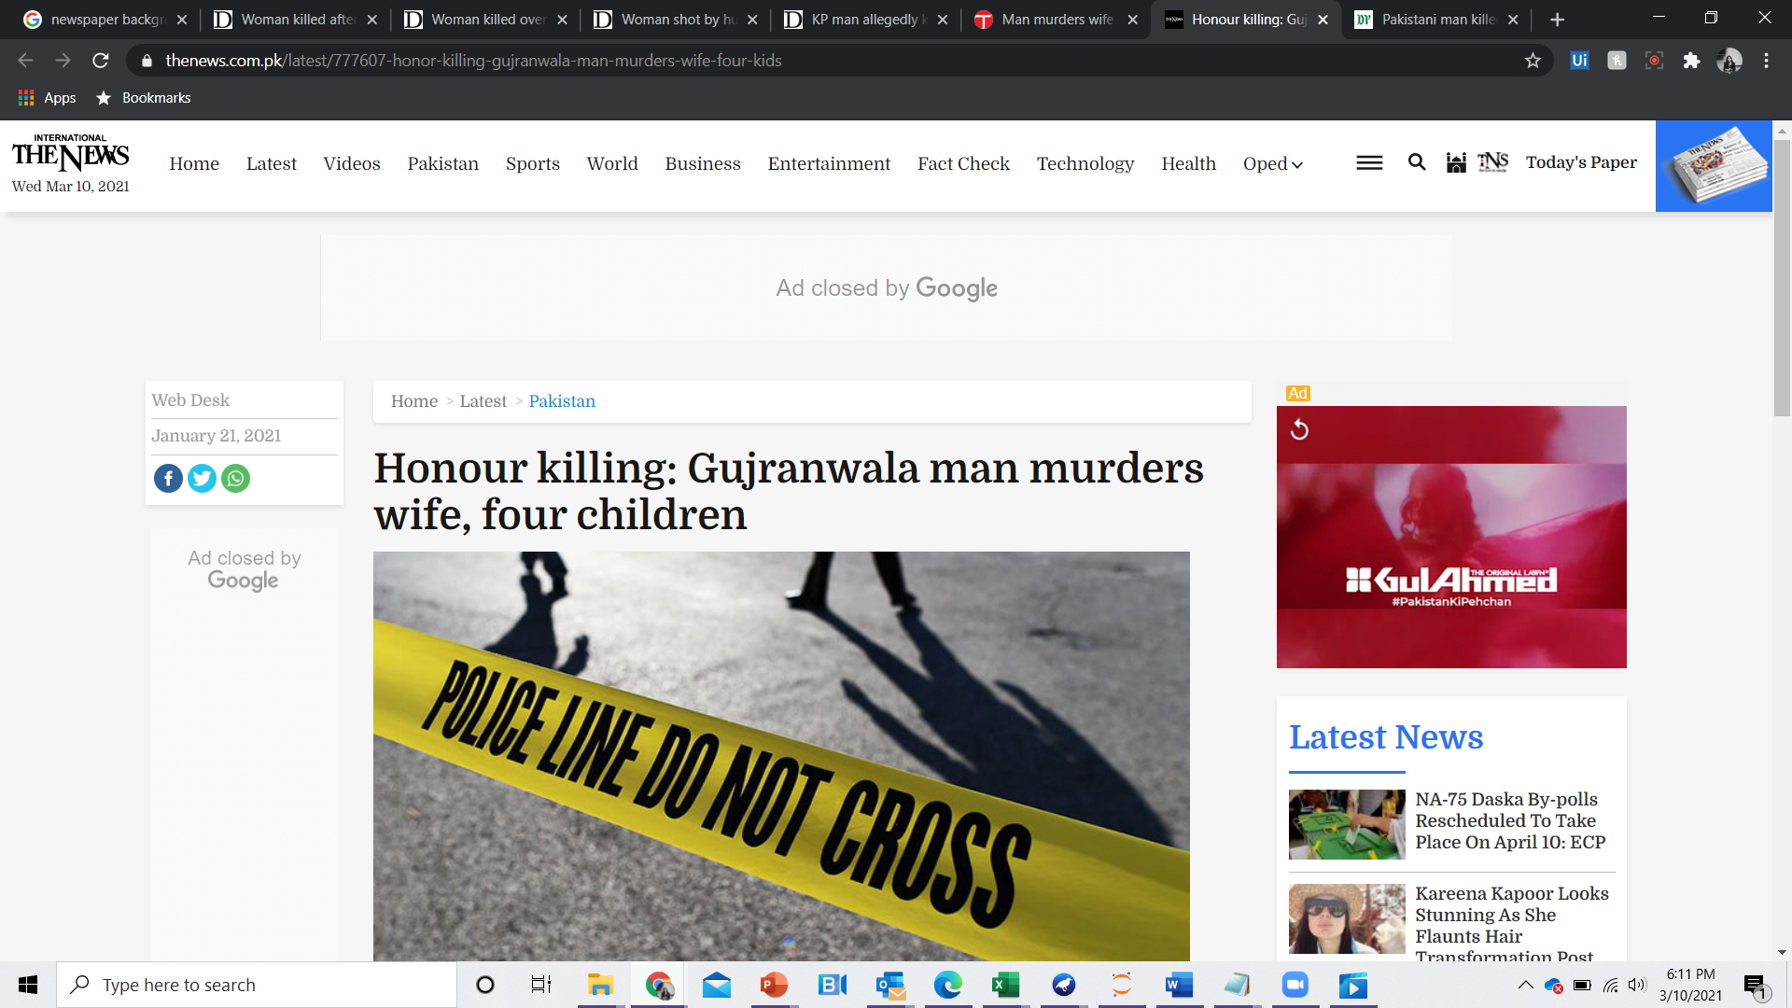
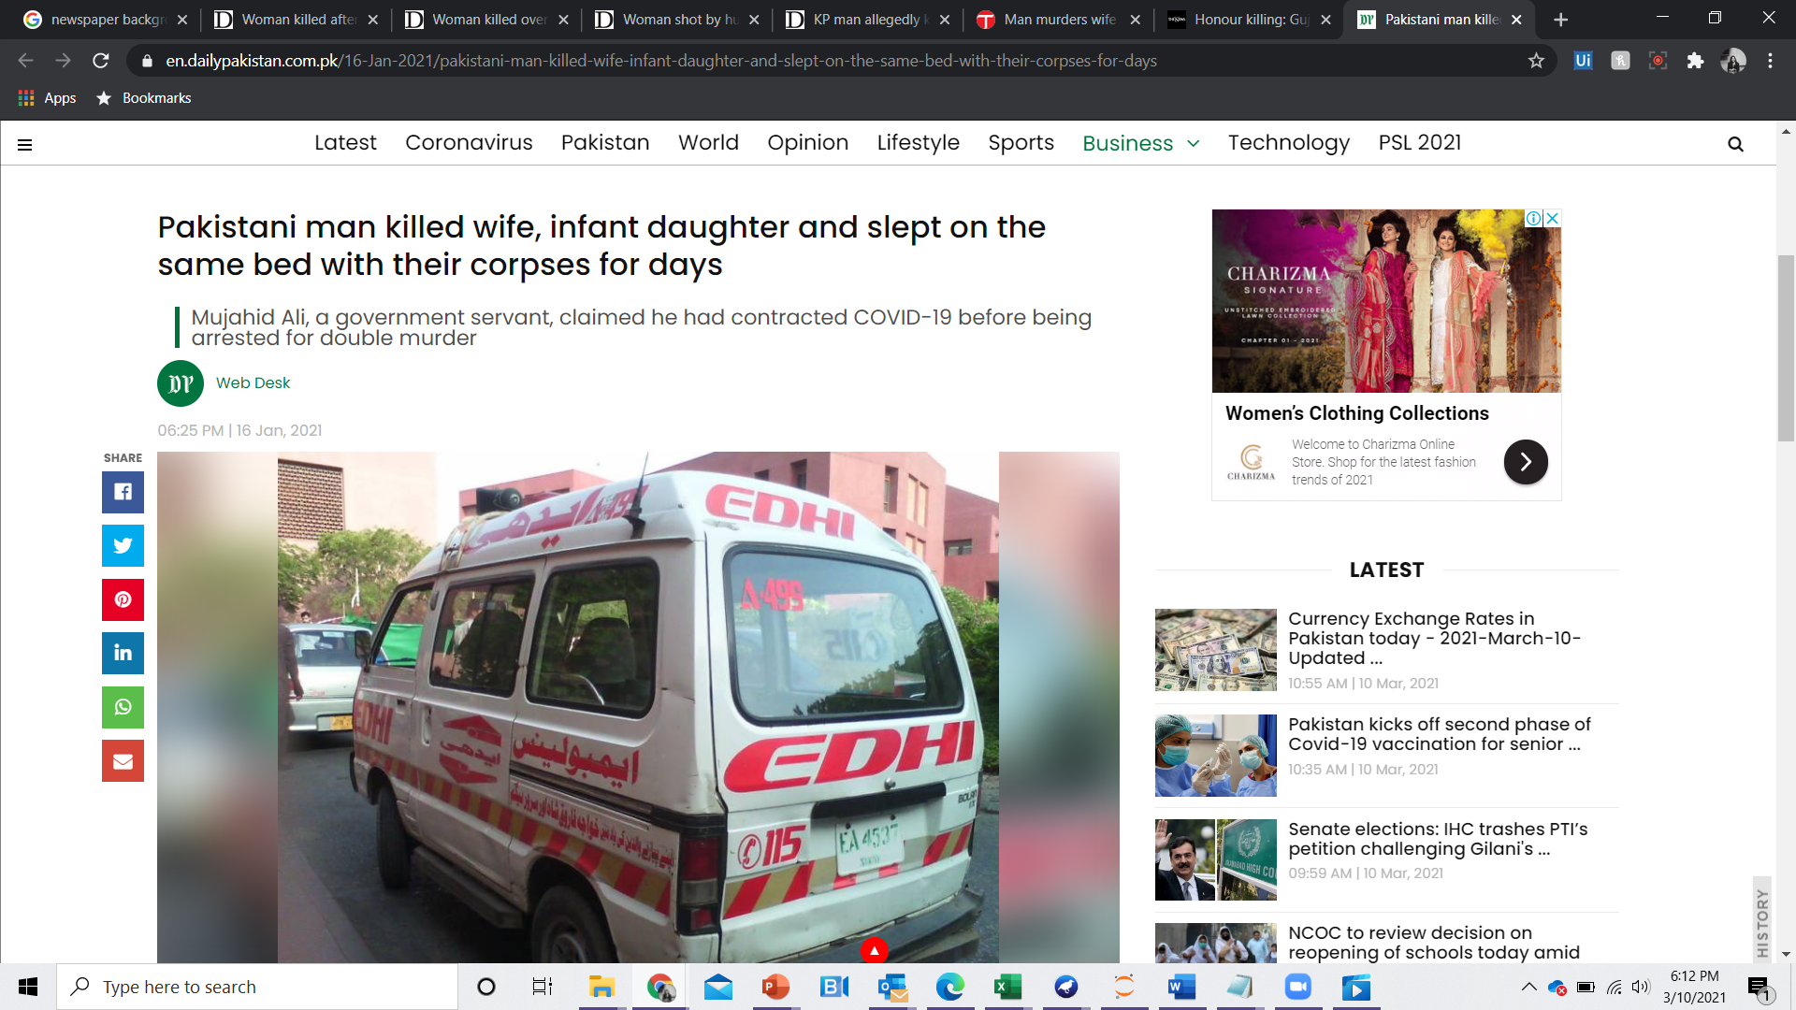
Pakistan is among the 6 most dangerous countries in the world for women
Thomson Reuters Foundation ^{[2]}
Pakistan is ranked 151 of 153 countries for Gender Gap Index
World Economic Forum ^{[1]}
34% of ever married women in Pakistan have experienced domestic violence
56% of women who experienced domestic violence have not sought help or talked to anyone about it
Pakistan Demographic & Health Survey ^{[3]}

Slide 3
Problem Statement
While domestic violence is the reality of at least 1 in 3 women in Pakistan, more than half the victims remain silent ^{[1]}. Due to the cultural norms and sociological nuances, Pakistani women from various demographics would fail to recognize spousal violence, downplay its gravity or would conceal it to protect the family’s honor. Hence identifying abusive households is often challenging for government agencies and NGOs working to support victims and hold perpetrators of domestic violence accountable. An indirect yet reliable means of identification can help in the prevention of ongoing and future violence
“

Slide 4
Solution Statement
To build a Machine Learning based classification system that the Government and NGOs can use to identify potential victims and perpetrators of spousal violence in Pakistan and target them for extending support, awareness and reformative activities without alerting perpetrators or explicitly asking victims to report the crimes
“

Slide 5
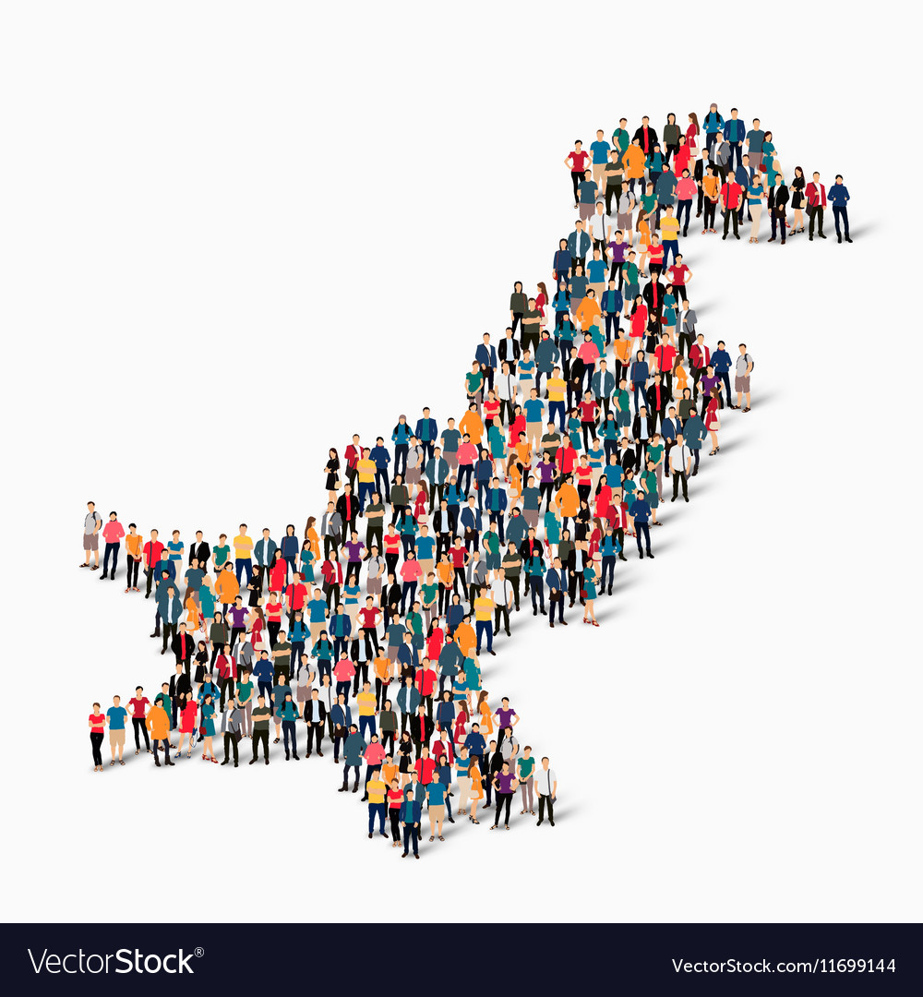

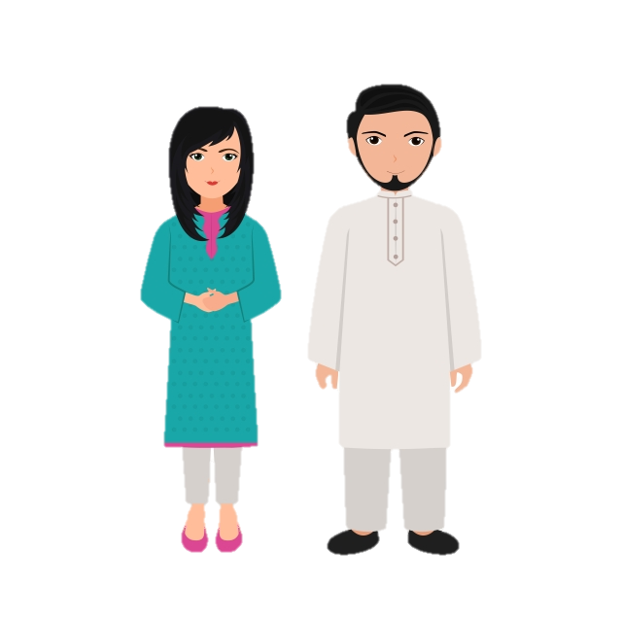



From Vision To Reality
Digital Pakistan will serve as a center point for collaborations with relevant organizations
Organizations will incorporate our surveys into their ongoing population studies. They will conduct surveys regularly across various demographics
Couples from all demographics of Pakistan
Partnership with Digital Pakistan Foundation
Collaboration with Anti Domestic Violence NGOs and Government Agencies
After Collection, survey data of each couple will be fed into identification system
Based on the analysis, organizations can plan their anti- domestic violence activities accordingly e.g.
Surveillance programs for perpetrators
Make support and resources more readily available to more susceptible victims (from medical aid to capacity building courses and legal facilitation
Target specific demographics for awareness and educational programs
Use the classifier analysis as a supplementary material in legal cases (e.g., divorce/ custody battles, domestic violence cases, other criminal cases), similar to use of credit rating in financial legalities
Governments can incorporate the analysis and related studies in policy making
Integration with NADRA
Identification System will output predictions (labels) for various types of domestic violence for each couple (e.g., Likely to slap/ have slapped wife: yes/no)
Will generate a violence score for each couple and categorize them into “unlikely”, “low risk”, “moderate risk”, “high risk”, “critical risk” accordingly
Identification System

Slide 6

WE HAVE SHOWN YOU OUR VISION SO FAR
NOW LET’S SEE WHAT IS HAPPENING BEHIND THE CURTAINS…

Slide 7


INPUT: SURVEY DATA FROM A COUPLE TO BE EXAMINED
TRAINED MODEL
OUTPUT: DOMESTIC
VIOLENCE ANALYSIS
Survey – Filled by agency interviewer
Data For Different Groups of Attributes
Deep Learning Classifier:
Multi – Layer Perceptron
Labeled Output Attributes
Violence Score & Category
✓
Ever been pushed, shook or had something thrown by husband
Wife Age | 15-24 | 25-34 | 34-45
Husband Education Level | No Education | Primary | Secondary | Higher
Wealth index | Poorest | Poorer | Middle | Richer | Richest
Total children ever born | 0 | 1 | 2 | 3 | 4 or more
Respondent's rank among wives | 0 | 1 | 2 or more
Husband's desire for children | Same as wife | Wants more | Wants fewer | Don’t Know
Wife can refuse sex | Yes | No | Don’t Know
Wife can ask partner to use a condom | Yes | No | Don’t Know
Wife justified refusing sex: husband has other women | Yes | No | Don’t Know
Person who usually decides on visits to family or relatives | Husband | Wife | Both | Other
Wife Says – beating justified if wife goes out without telling | Yes | No | Don’t Know
Wife Says – beating justified if wife refuses sex | Yes | No | Don’t Know
Wife Says – beating justified if wife burns the food | Yes | No | Don’t Know
Wife Says – beating justified for at least one specific reason | Yes | No | Don’t Know
Husband’ Says – beating justified: wife goes out without telling | Yes | No | Don’t Know
Husband Says – beating justified: wife argues with husband | Yes | No | Don’t Know
Owns a house alone or jointly-husband | Alone Only | Jointly Only | Alone & Jointly | Doesn’t Own
Presence of husband for 'wife beating justified' questions | Yes – Listening | Yes – Not Listening | No
Number of control issues demonstrated by husband | 1 | 2 | 3 | 4 | 5
Frequency of husband/partner being drunk | Often | Sometimes | Never | N/A
Wife's father ever beat her mother | Yes | No | Don’t Know
Wife afraid of husband/partner | Mostly Afraid | Sometimes Afraid | Never Afraid
Had a say in choosing the husband | Yes | No
Wife Experienced any emotional violence | Yes | No
sometimes
✓
✓
✓
✓
Ever been slapped by husband
✓
often
✓
✓
✓
✓
Score:
###
Category: “High”
✓
✓
✓
✓
✓
Ever been punched with fist or hit by something harmful by husband
✓
often
✓
✓
✓
…
✓
…
✓
✓
ever had wounds, broken bones/ teeth or other serious injury because of husband
✓
never
✓

Slide 8
Datasets
DATASET 1
20200306 Data International Women's Day Viz5 Launch.csv
Source: WaiDatathon Organizers
View Complete Dataset
DATASET 2
Raw data for Pakistan Demographics and Health Survey 2017-2018.
Chapter 16: Domestic Violence
Source: The Demographic and Health Surveys (DHS) Program, USAID
Complete raw dataset cannot be shared beyond the research team due to restriction on rights. Please see the tables in chapter 16 for an idea of the sort of attributes for which we have obtained raw records
View Survey Report

Slide 9
Approach
Step 01
Explore the global data
Step 02
Explore local findings (Pakistan) and compare with global findings
Step 03
Mapping perceptions around justification of domestic violence to actual occurrences
Step 04
Build a predictive model with practical utility in combating domestic violence in Pakistan

Slide 10
Understanding Dataset 1
A husband is justified in hitting or beating his wife :
if she burns the food
if she argues with him
if she goes out without telling him
if she neglects the children
if she refuses to have sex with him
for at least one specific reason
RecordID | Country | Gender | Demographics Question | Demographics Response | Question | Survey Year | Value
1 | Afghanistan | F | Education | Higher | ... if she burns the food | 1/1/2015 | 10.1
1 | Afghanistan | F | Education | Secondary | ... if she burns the food | 1/1/2015 | 13.7
71 | Afghanistan | M | Age | 15-24 | ... if she argues with him | 1/1/2015 | 44.4
146 | Bangladesh | F | Employment | Unemployed | ... if she goes out without telling him | 1/1/2014 | 14.2
Numeric value unique to each question by country
Age
Education
Employment
Marital Status
Residence
15-24 , 25-34 , 35-49
No Education, Primary, Secondary, Higher
For Cash, For Kind, Unemployed
Married, Never Married, Widowed/Divorced/Separated
Urban, Rural
% of people surveyed in the relevant group who agree with the question – i.e. Justify violence in the given scenario

Slide 11
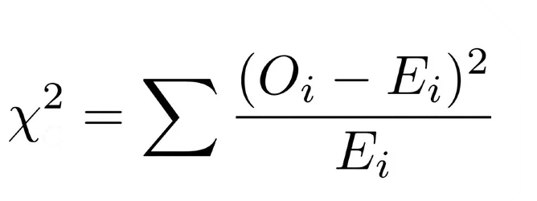
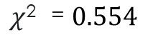
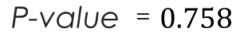
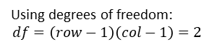
Statistical Measurement
Observed Values
Age | Justified “if she argues with him” | Not justified “if she argues with him” | Total
15-24 | 35 | 65 | 100
25-34 | 30.9 | 69.1 | 100
35-49 | 30.6 | 69.4 | 100
Total | 96.5 | 203.5 | 300
$$\text{P}\text{−}\text{value} =0.758$$
P-value > 0.05 :. Null hypothesis accepted
No significant relationship observed between age and Justified Value for this specific question within the Pakistan, Female demographic
Using degrees of freedom:
$$df=\left(row−1\right)\left(col−1\right)=2$$
$$\text{χ}\text{2} =0.554$$
Expected Values
Deviation
Age | Justified “if she argues with him” | Not justified “if she argues with him” | Total
15-24 | 32.17 | 67.83 | 100
25-34 | 32.17 | 67.83 | 100
35-49 | 32.17 | 67.83 | 100
Total | 96.5 | 203.5 | 300
Age | Justified “if she argues with him” | Not justified “if she argues with him”
15-24 | 0.25 | 0.12
25-34 | 0.05 | 0.02
35-49 | 0.08 | 0.04

Slide 12
Statistical Measurement
The test is repeated for all demographics across each country and gender
Results of all the questions across a particular demographic within a country and gender are displayed as consolidated values in the following ways:
Individual P value of chosen Demographic group (e.g. age)against Justified “for any specific reason”
Average P value of chosen Demographic group against all 6 questions
Significance ratio: ( num of questions with significant p values/ total questions) within chosen demographic group, country and gender
Note:
Average P value is not a reliable measures because a few cases with very high p value can dampen the effect of multiple cases with low p value

Slide 13
Result Summary
 | p value > 0.05 between the demographic and "justified" for "at least one specific reason" |  |  |  | average p value > 0.05 between the demographic and "justified" for all questions |  |  |  | p value > 0.05 for majority of the questions, i.e. significance ratio>50%
 | Male | Female | Overalll |  | Male | Female | Overalll |  | Male | Female | Overalll
Education | 43 | 54 | 97 |  | 20 | 45 | 65 |  | 29 | 49 | 78
Residence | 12 | 28 | 40 |  | 4 | 18 | 22 |  | 14 | 18 | 32
Employment | 15 | 17 | 32 |  | 2 | 8 | 10 |  | 6 | 10 | 16
Marital Status | 12 | 6 | 18 |  | 0 | 3 | 3 |  | 5 | 3 | 8
Age | 8 | 2 | 10 |  | 0 | 0 | 0 |  | 1 | 0 | 1
WORLD WIDE –
Number of Countries in which each Demographic showed a significant relationship with Justification of Domestic Violence
Countries within South Asia: Bangladesh, Bhutan, India, Maldives, Nepal, Pakistan, Srilanka. Note: Bhutan and Sri Lanka are not present within the given data set
 | p value > 0.05 between the demographic and "justified" for "at least one specific reason" |  |  |  | average p value > 0.05 between the demographic and "justified" for all questions |  |  |  | p value > 0.05 for majority of the questions, i.e. significance ratio>50%
 | Male | Female | Overalll |  | Male | Female | Overalll |  | Male | Female | Overalll
Education | 2 | 2 | 4 |  | 0 | 1 | 1 |  | 2 | 1 | 3
Residence | 1 | 1 | 2 |  | 0 | 1 | 1 |  | 1 | 1 | 2
Employment | 1 | 1 | 2 |  | 0 | 1 | 1 |  | 1 | 1 | 2
Marital Status | 1 | 0 | 1 |  | 0 | 0 | 0 |  | 1 | 0 | 1
Age | 0 | 0 | 0 |  | 0 | 0 | 0 |  | 0 | 0 | 0
South Asia –
Number of Countries in which each Demographic showed a significant relationship with Justification of Domestic Violence
Worldwide and South Asian countries follow the same order from most to least significant attribute:
Education, Residence, Employment, marital status, Age
In the worldwide data, all attributes show a higher number of countries with significant results for men than women. i.e. the results for men appear to be more random than the results for women

Slide 14
Result Summary – Pakistan (p – values)
Relationship between Demographic and Justification of Domestic Violence
 | p value > 0.05 between the demographic and "justified" for "at least one specific reason" |  |  |  | average p value > 0.05 between the demographic and "justified" for all questions |  |  |  | p value > 0.05 for majority of the questions, i.e. significance ratio>50%
 | Male | Female |  |  | Male | Female |  |  | Male | Female
Education | 0.00000104 | 0.00000003 |  |  | 0.08728960 | 0.00000295 |  |  | 83% | 100%
Residence | 0.00132869 | 0.00046860 |  |  | 0.07099274 | 0.00139865 |  |  | 89% | 89%
Employment | 0.00799872 | 0.00302067 |  |  | 0.10680020 | 0.03690573 |  |  | 67% | 67%
Marital Status | 0.49707248 | 0.61259325 |  |  | 0.26221497 | 0.71062494 |  |  | 33% | 0%
Age | 0.21587687 | 0.69913108 |  |  | 0.42820068 | 0.77476791 |  |  | 0% | 0%
The results of Pakistan follow the same order of significance as observed in worldwide and South Asian countries
Education seems to be the most significant demographic, followed by Residence.
Marital status and age do not show significant trends
P values are higher for men than women indicating more randomness in men’s data
Which questions contribute the least and most randomness
Justification | Number of records with p value < 0.05 | Number of records with p value > 0.05
... if she refuses to have sex with him | 18 | 12
... if she neglects the children | 16 | 14
... if she goes out without telling him | 15 | 15
... if she burns the food | 6 | 24
... if she argues with him | 21 | 9
... for at least one specific reason | 18 | 12
Most Random Spread
Least Random Spread

Slide 15
Conclusions – Dataset 1
1 | Trend of significance follows a consistent order. Whether we consider Worldwide, South Asia or Just Pakistan, the most significant attribute is education, followed by residence, employment, marital status and then age
2 | Age is the least significant attribute with significance visible in very few countries worldwide and no country in South Asia.
3 | In majority of the cases, Female responses follow a significant pattern whereas Male responses appear more random.
4 | In Pakistan, Education, Residence and Employment show the most significant relationship with justification of violence. Responses of men seem to be more random than those of women
5 | If we observe Pakistan Data, sorted by p value, and look at the number of significant orders against each question, we see that the question "… if she burns the food" contributes the most randomness Meanwhile "… if she argues with him" shows the most consistency
6 | If we look at the graphs, yellow bars (representing women's responses) are longer than black bars (men's responses). We can clearly see that in most cases, women in Pakistan justify domestic violence against wives more than men do. This could be an indication of internalized misogyny. The rationale needs to be investigated further
7 | Although these questions give us an idea of the perceptions surrounding domestic violence, they may not be the best metric for determining a person's potential to perpetrate or be victimized by domestic violence. There is a chance that abusers might hide their true perceptions from interviewers and may provide misleading responses Presence of abuser during interviews could also influence victims' responses More insights can be derived from reports of actual incidents of abuse rather than mere reports of perception
8 | As we are given percentage aggregates, we cannot observe how different permutations and combinations of demographics may work together to influence the occurrence of and perception around domestic violence. For this, we would need raw data records
9 | We are not given any information on the number of participants overall or in a specific demographic category. Hence, we don’t know if our data is biased. We are hence working with the assumption that the data is uniform and we have equal numbers of people from each demographic

Slide 16
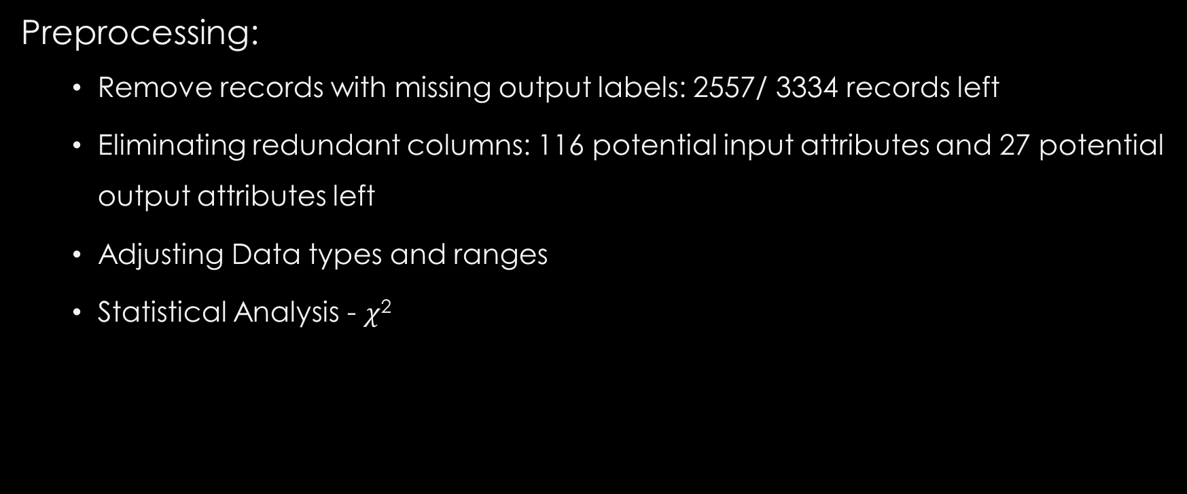
Analysis of Dataset 2
Preprocessing:
Remove records with missing output labels: 2557/ 3334 records left
Eliminating redundant columns: 116 potential input attributes and 27 potential output attributes left
Adjusting Data types and ranges
Statistical Analysis - $\text{χ}\text{2}$

Slide 17
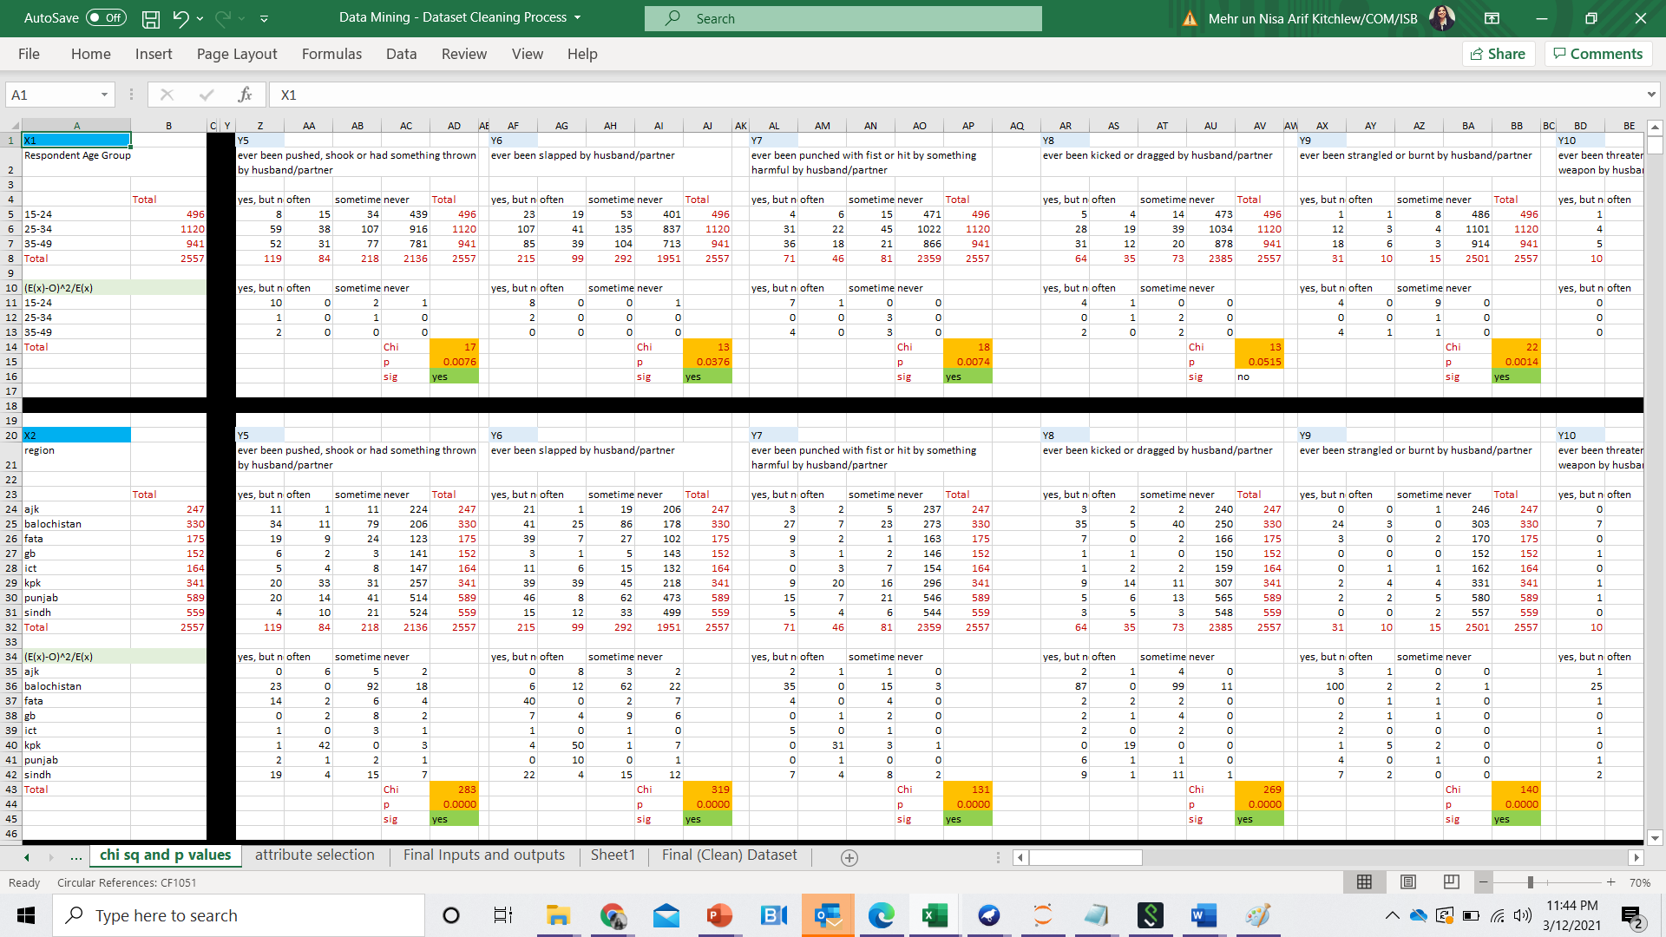

Slide 18
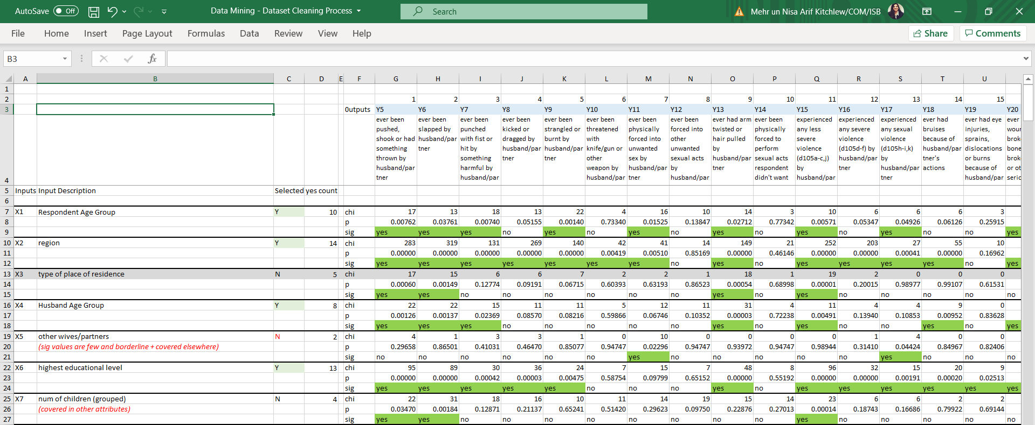
Eliminate inputs for which there are
Very few outputs with significant p values
The few values are all borderline
Convey no new information

Slide 19
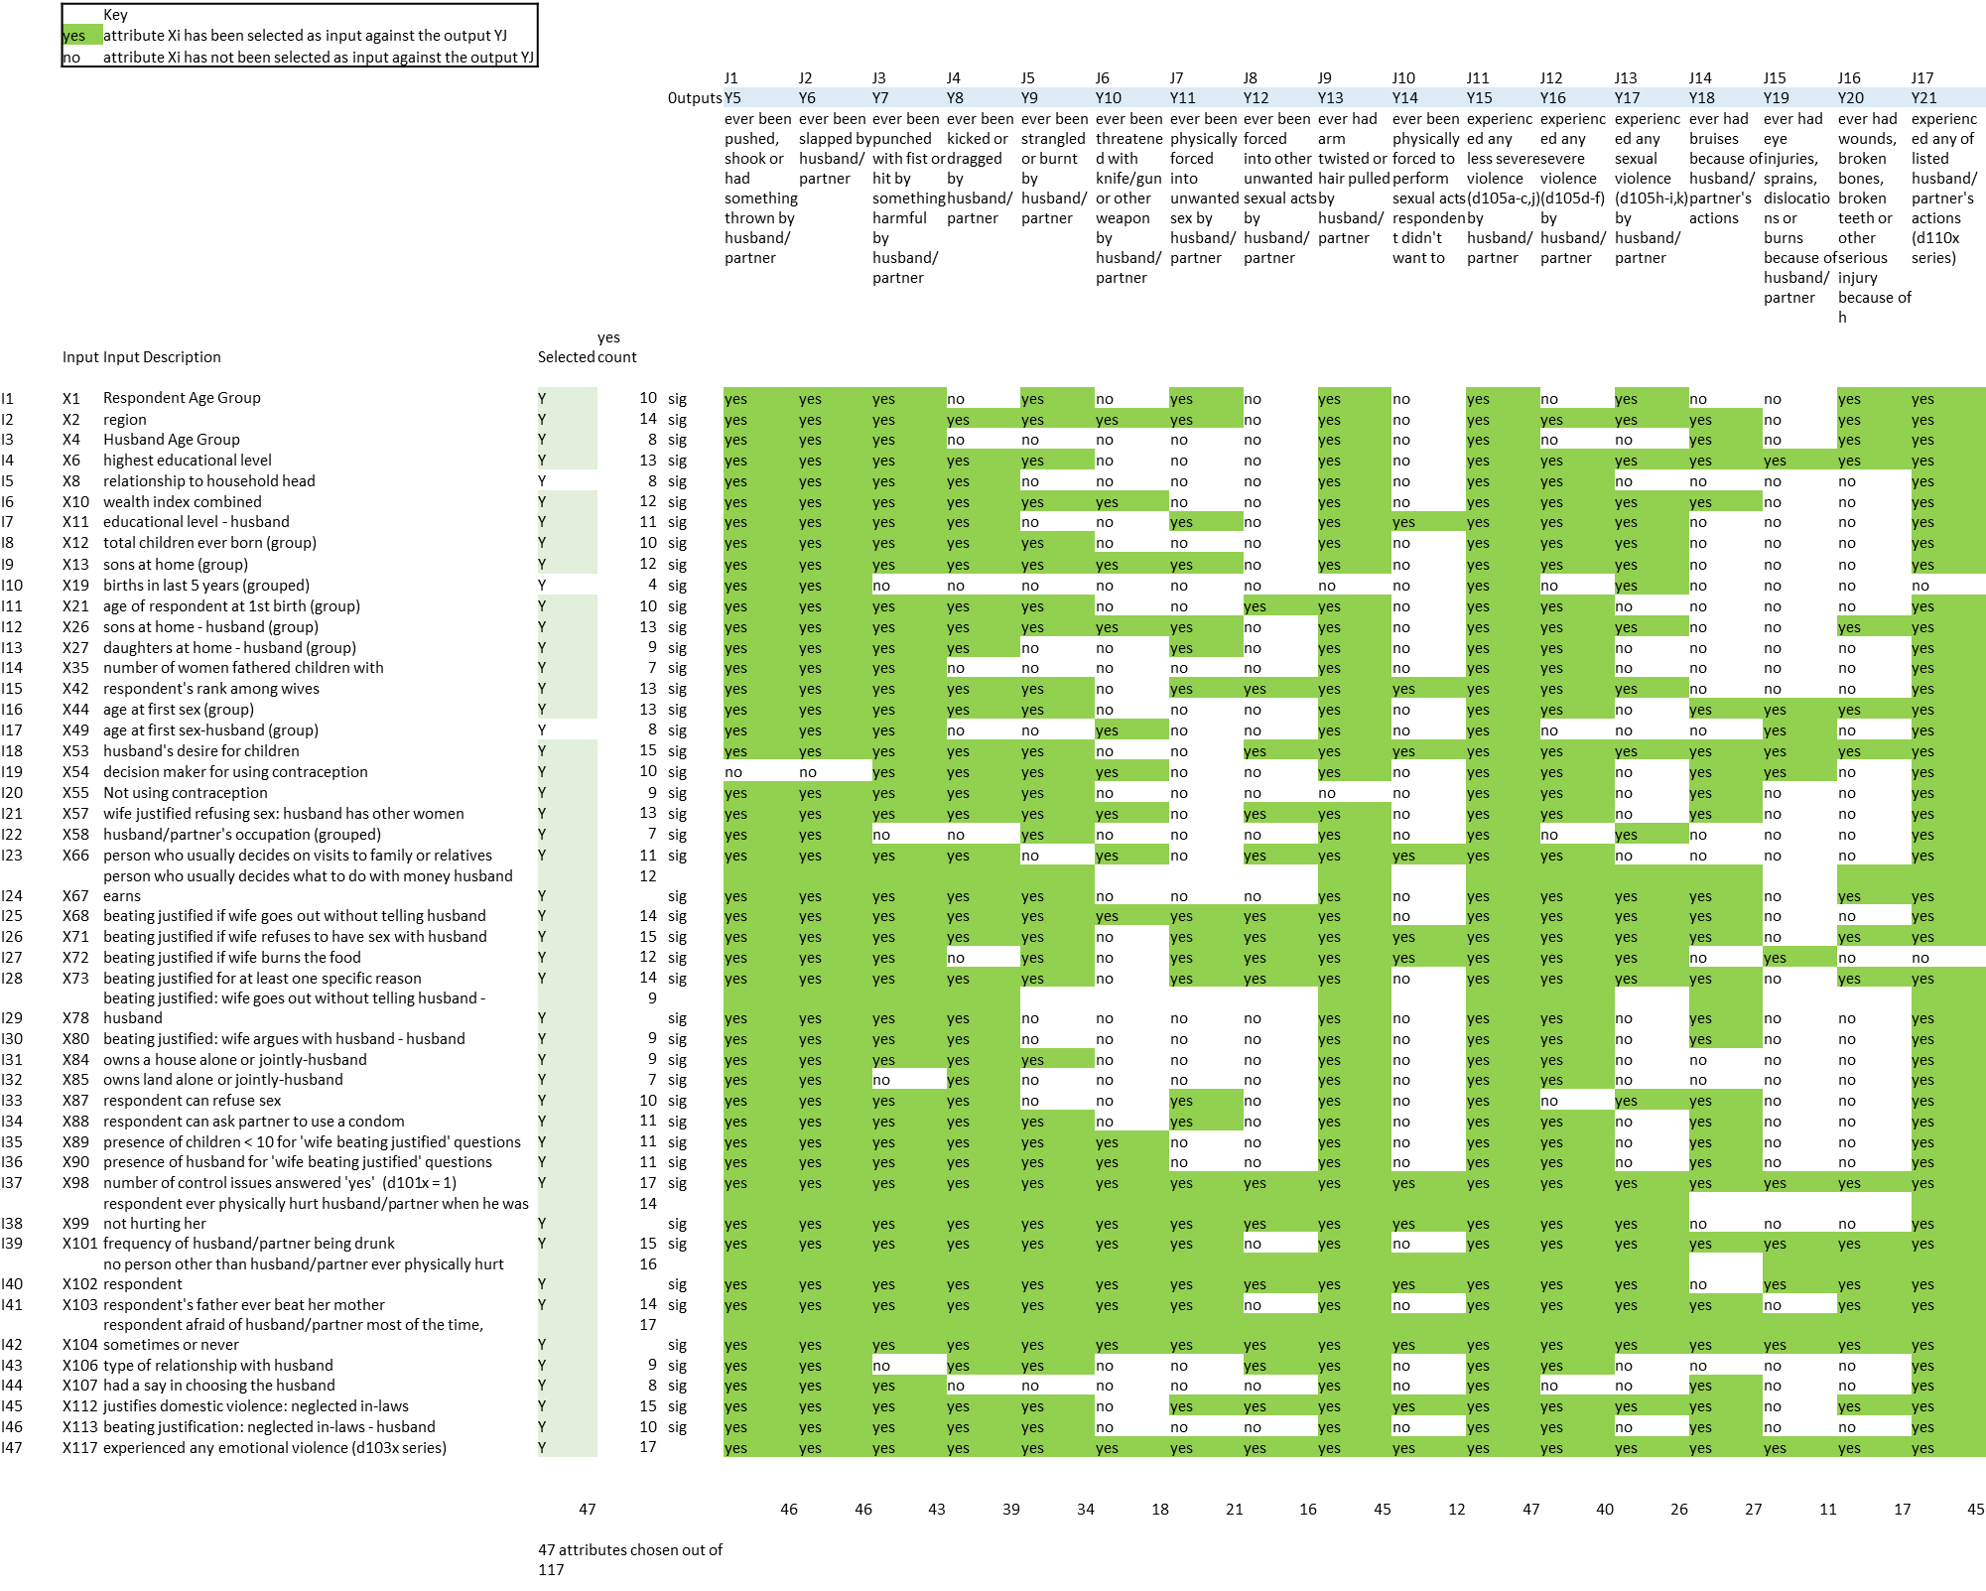
Dynamic Feature Selection for each output
For each output Jx, only use inputs in green i.e., p value <0.05
Separate Classifier configurations for each output.

Slide 20
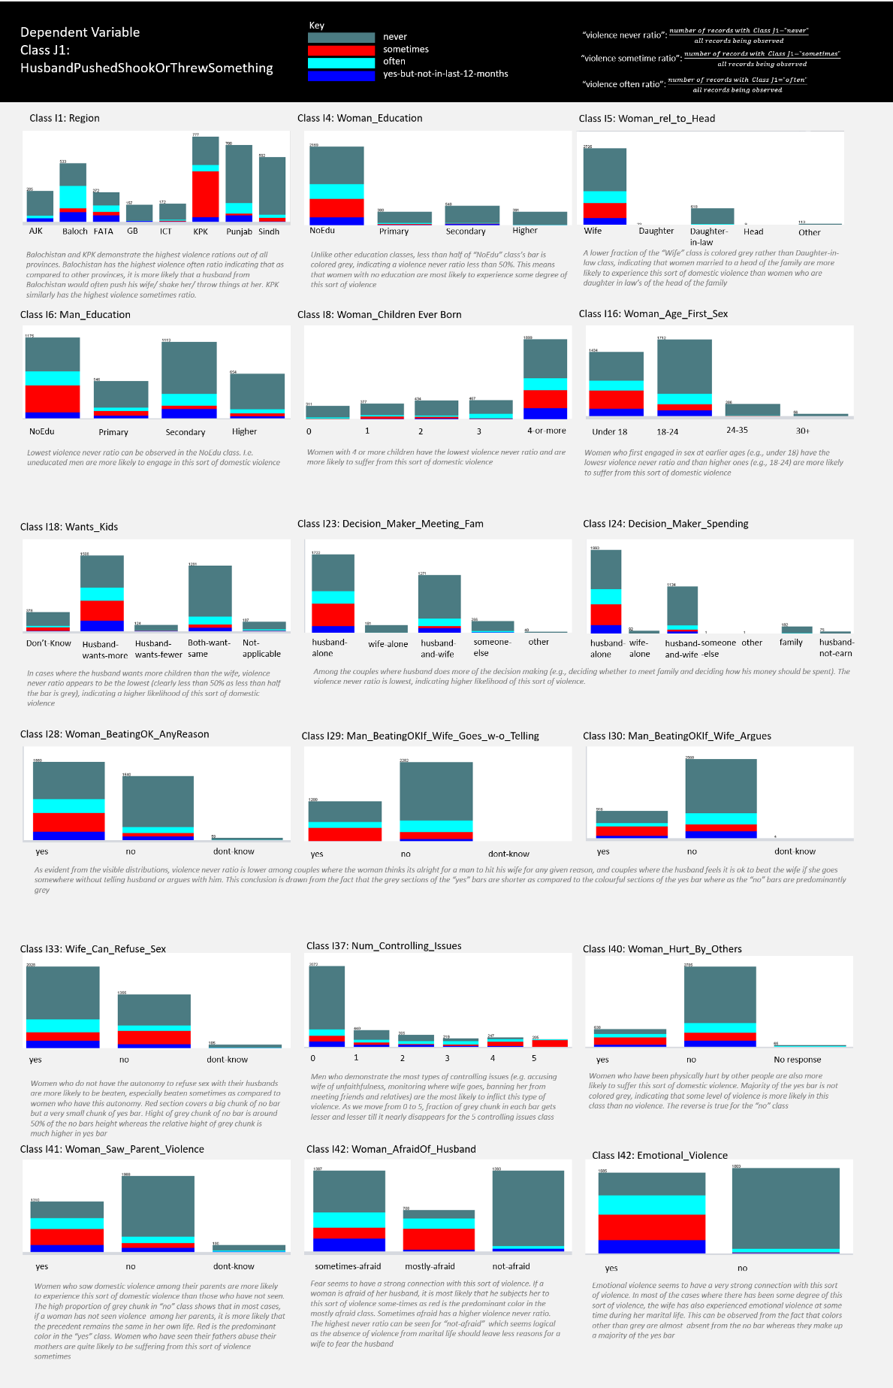

Slide 22
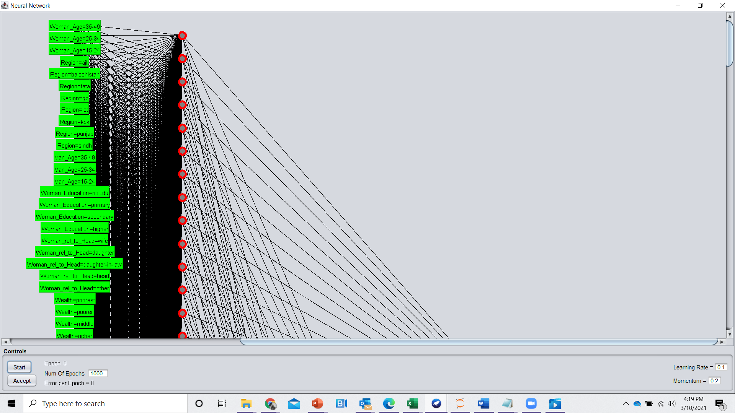
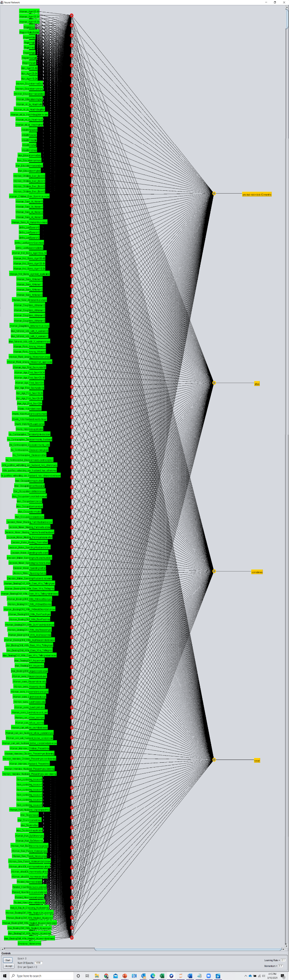
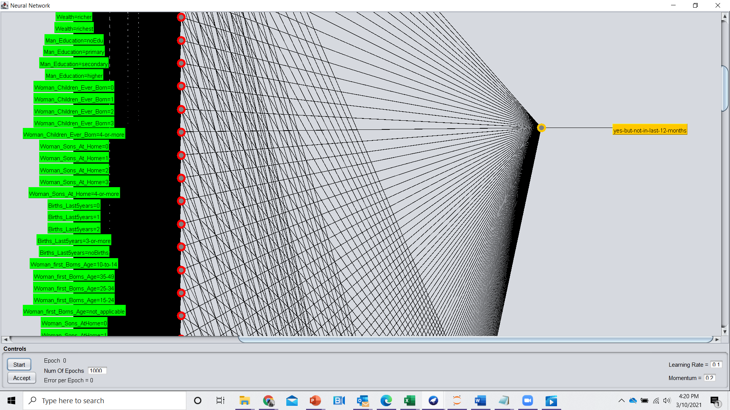
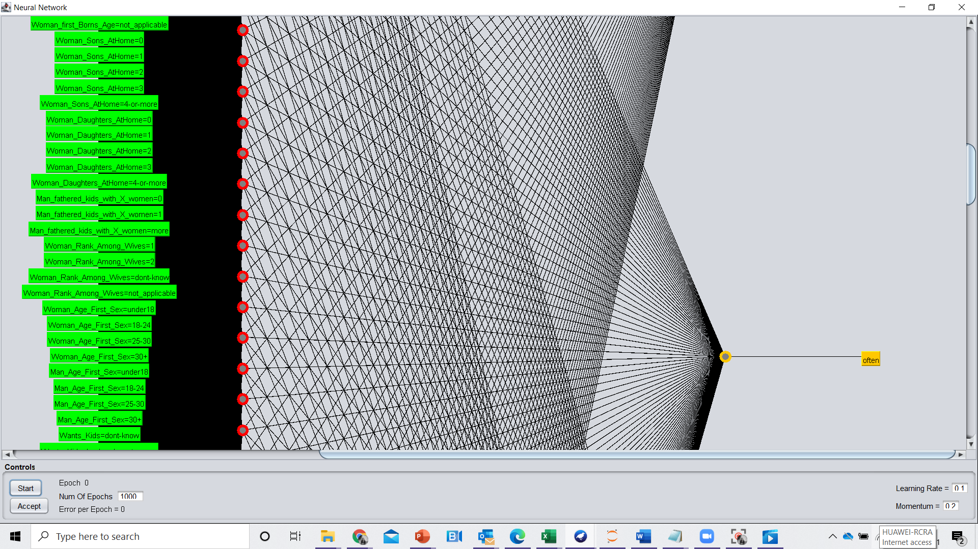
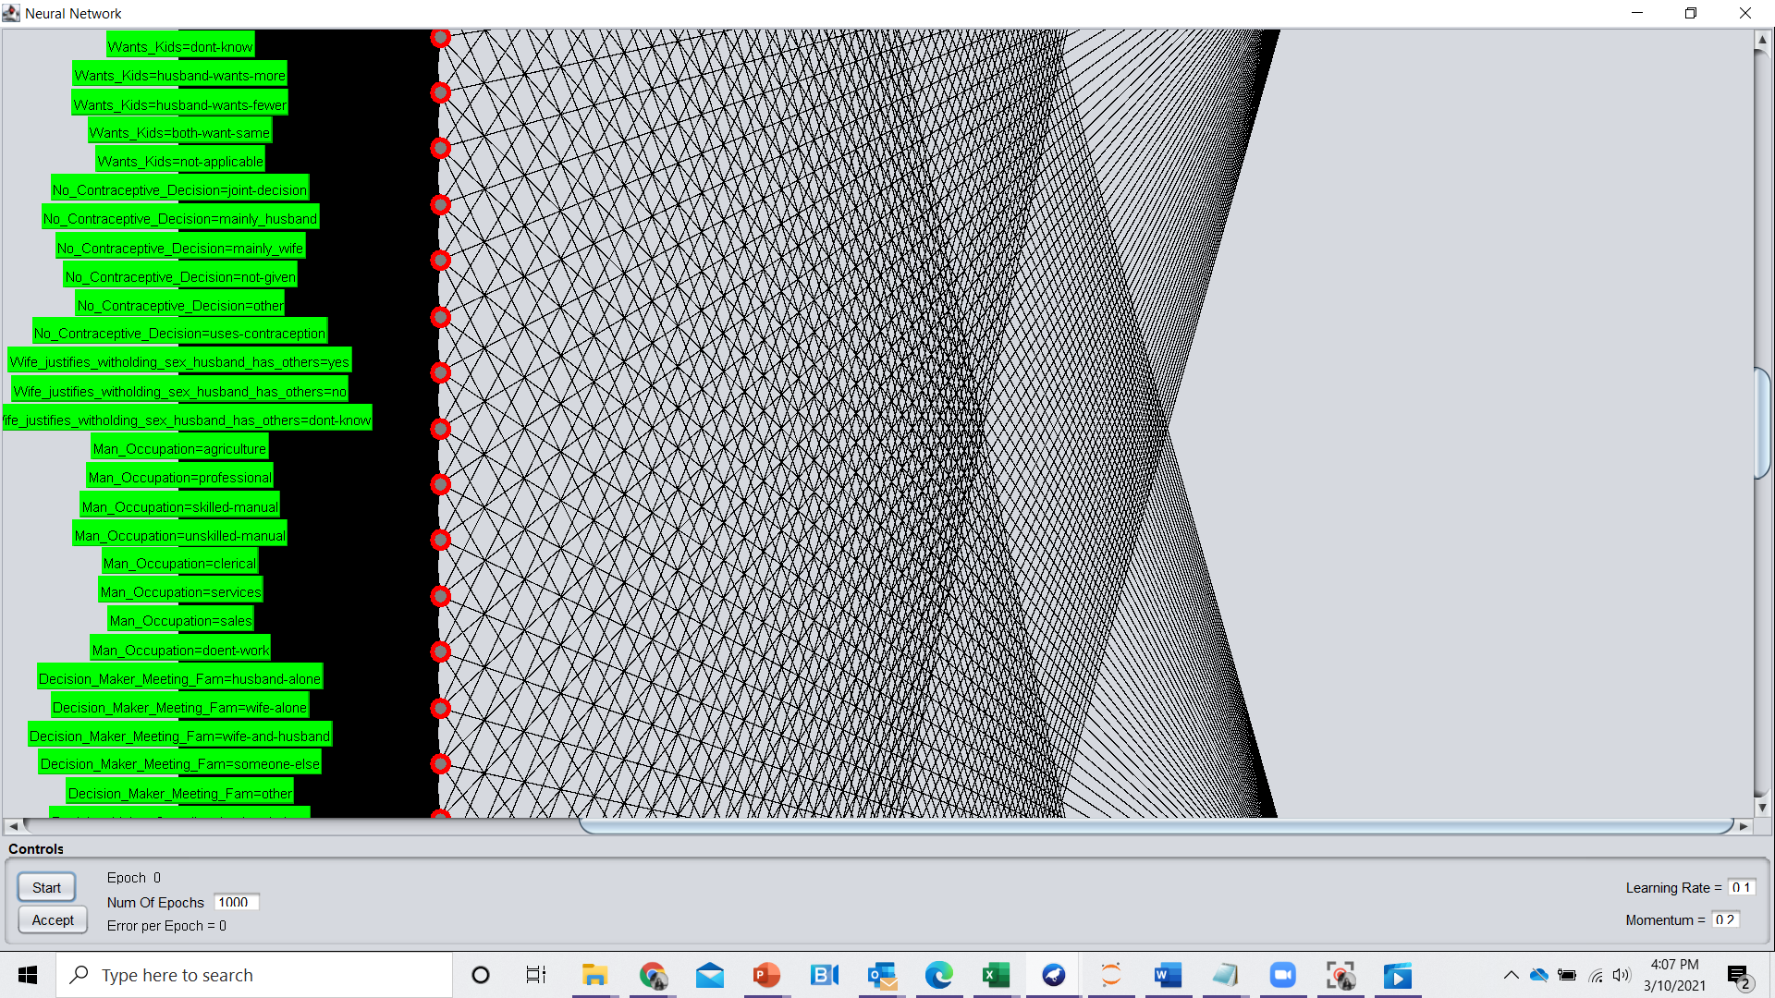
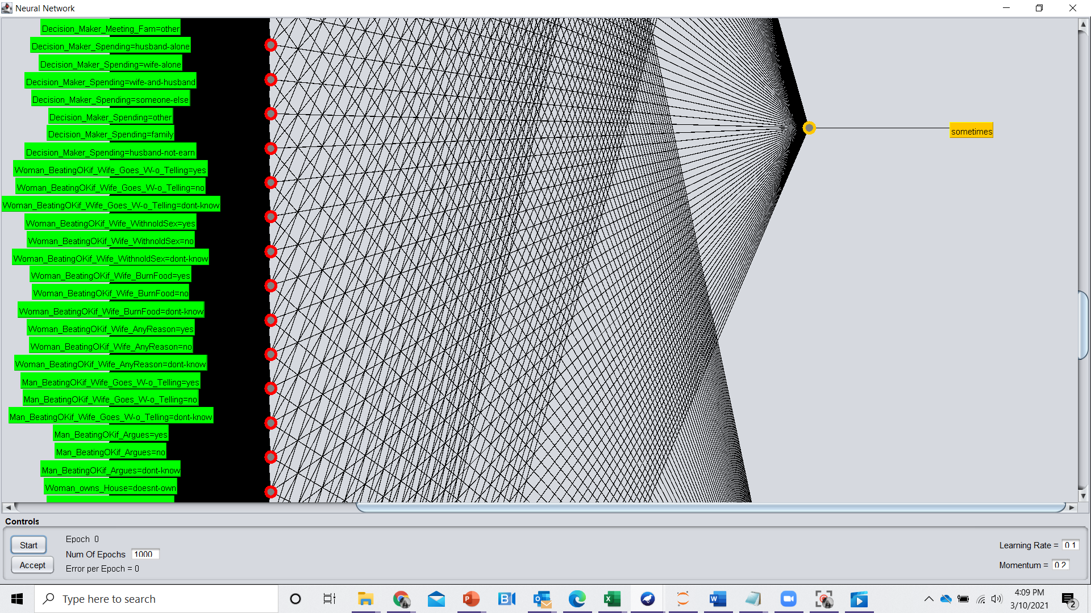
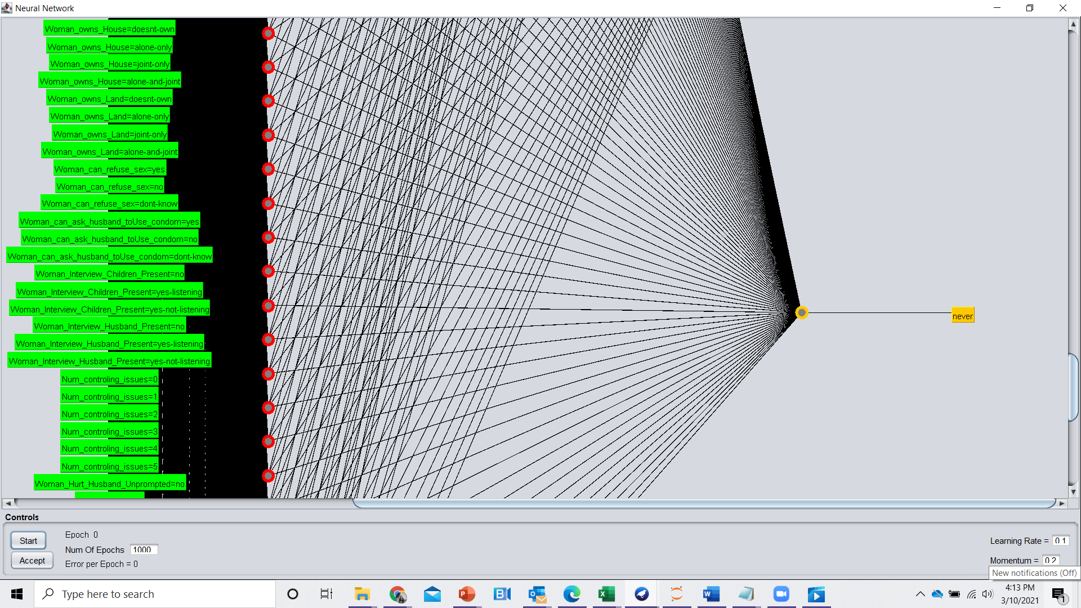
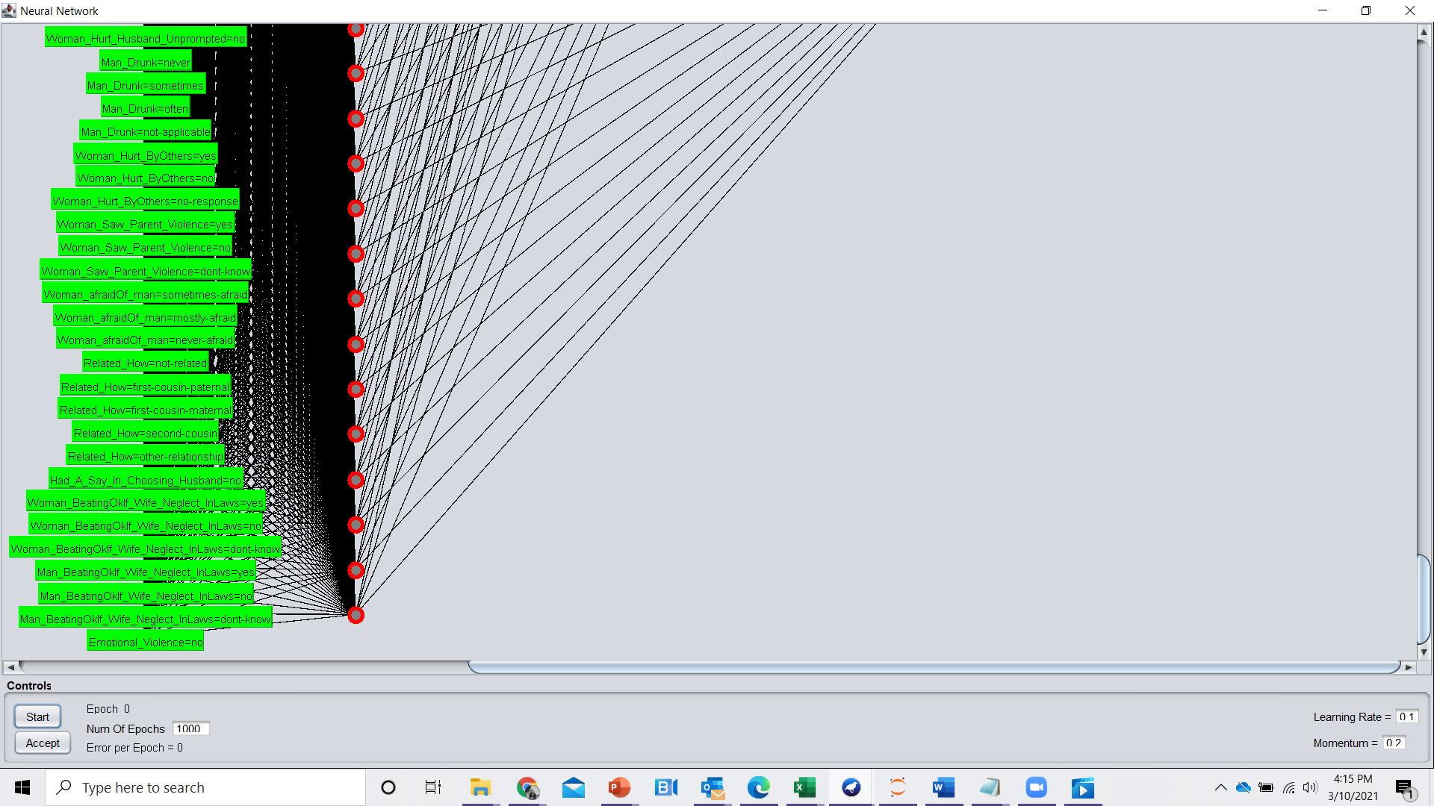
ABOUT THE MODEL
Multi Layer Perceptron (Neural Network)
Implemented on Weka Tool
Different configurations will be needed for each output variable
Configurations for Output J1: “Ever pushed shook or had something thrown by husband:
Training-Test split: 80%
Batch Size: 100
Momentum: 0.2
Learning Rate: 0.1
Training time: 500
Hidden Layers: 0
Number of input attributes: 46
Number of sigmoid nodes: 96

Slide 23
PERFORMANCE EVALUATION FOR OUTPUT J1: “Ever pushed shook or had something thrown by husband”
=== Summary ===
Correctly Classified Instances 612 87.93 %
Incorrectly Classified Instances 84 12.07 %
Mean absolute error 0.0678
Total Number of Instances 696
=== Detailed Accuracy By Class ===
TP Rate FP Rate Precision Recall F-Measure ROC Area Class
0.805 0.018 0.849 0.805 0.827 0.961 yes-but-not-in-last-12-months
0.803 0.016 0.841 0.803 0.822 0.969 often
0.788 0.044 0.806 0.788 0.797 0.940 sometimes
0.933 0.138 0.912 0.933 0.923 0.955 never
Weighted Avg. 0.879 0.095 0.878 0.879 0.925
=== Confusion Matrix ===
a b c d <-- classified as
62 3 4 8 | a = yes-but-not-in-last-12-months
0 53 5 8 | b = often
3 3 104 22 | c = sometimes
8 4 16 393 | d = never

Slide 24
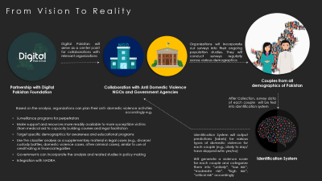
Future Work
Calibrate models for even better performance. Consider further training models
Build the scoring system to integrate outputs: use weight to prioritize high intensity output variables (e.g. likely to slap < likely to break bones) and high frequency labels (e.g. sometimes < often )
Build a front-end interface for stakeholder organizations
Build partnerships and implement pilots
Use police FIRs data to further validate models
Bring my Vision into reality for a better, safer Pakistan!

Slide 25
References
[1] Crotti, R., Geiger, T., Ratcheva, V., Zahidi, S. (2020). The Global Gender Gap Report, 2020. World Economic Forum, 2020
[2] Thomson Reuters Foundation. (2017). The world’s most dangerous megacities for women. Retrieved from http://poll2017.trust.org/ [Google Scholar]
[3] National Institute of Population Studies and Macro International. (2018). Pakistan demographic and health survey 2017–18. Islamabad: National Institute of Population Studies and Macro International.

